Slide 1
Presented By:
ARuN singhal
Topic:Regular Expression

Slide 2
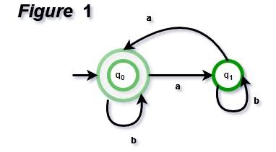
Defination:Regular Expression
The language accepted by finite automata can be easily describe simple expressions called Regular Expressions.
A regular expression can also be described as a sequence of pattern that defines a string.Regular expressions are used to match character combinations in strings.

Slide 3
Operations on regular Language:
1..Union: If L and M are two regular languages then their union L U M is also a union.
L U M = {s | s is in L or s is in M}
2.. Intersection: If L and M are two regular languages then their intersection is also an intersect.
L ⋂ M = {st | s is in L and t is in M}

Slide 4
Kleen closure: If L is a regular language then its Kleen closure L1* will also be a regular language.
L* = Zero or more occurrence of language l

Slide 5
ThankYou

